Slide 1
IBM University Engagement Project Submission
“Exploring the Power of Agentic AI with IBM Granite and LangFlow”

Slide 2

Project Tile – [The Smart Mechanical Fault Diagnosis Agent]
Domain of Project – [ Mechanical Engineering and AI]
Student Name | Recent Passport Photo | Email ID | Mobile number [WhatsApp]
Aditya Sunil Tupe |  | adityatupe38@gmail.com | +919321810165
Recommended font style and size: Font Style: Arial Font Size (Heading): 28
Font Size (Content): 20

Slide 3
Problem Statement -
Problem Statement : The Smart Mechanical Fault Diagnosis Agent
The Challenge Mechanical systems such as engines, pumps, and gearboxes often experience faults that are difficult to diagnose quickly. Engineers and technicians typically rely on manual inspections, experience, and trial‑and‑error troubleshooting methods. This process can lead to extended downtime, higher maintenance costs, and inefficient repair processes. The Objective Build an AI-powered Mechanical Fault Diagnosis Agent that analyzes machine symptoms, sensor data, and historical maintenance logs to identify possible mechanical faults.
1.Fault Data Retrieval (RAG) :– Collect historical fault records and maintenance logs.
2. Symptom Analysis :– Analyze vibration patterns, noise signals, and temperature anomalies.
3. Root Cause Identification :– Identify the most probable cause of failure. Repair Guidance – Provide recommended repair procedures.
4. Multi-Agent System • Symptom Detection Agent – Collects machine symptoms and sensor signals. • Fault Analysis Agent – Matches symptoms with known fault patterns. • Root Cause Agent – Determines the probable mechanical issue. • Repair Guidance Agent – Suggests troubleshooting and repair procedures.
5. Visualization Dashboard Display fault alerts, root cause explanations, and repair recommendations.
Tech Stack • IBM Langflow / IBM Orchestrate + IBM Models

Slide 4
Proposed Solution -
Proposed Solution – The Smart Mechanical Fault Diagnosis Agent
The proposed solution is to develop an AI-powered multi-agent system capable of diagnosing mechanical faults intelligently and efficiently. The system will integrate sensor data, historical maintenance logs, and machine learning models to predict, analyze, and guide repair actions for mechanical systems such as engines, pumps, and gearboxes.
Data Integration and Preprocessing: Collect and preprocess data from vibration sensors, temperature sensors, and maintenance logs using IBM Langflow pipelines. Ensure data consistency and remove noise for accurate analysis.
Symptom Detection Agent: Continuously monitor real-time sensor data to detect anomalies in vibration, noise, and temperature patterns. Trigger alerts when deviations from normal operating conditions are observed.
Fault Analysis Agent: Utilize trained AI models to match detected symptoms with known fault patterns. Classify faults based on severity and type using IBM Models for predictive analytics.
Root Cause Agent: Apply reasoning algorithms to identify the most probable cause of failure. Use historical data correlations and pattern recognition to pinpoint mechanical issues.
Repair Guidance Agent: Generate recommended troubleshooting and repair procedures based on identified faults. Provide step-by-step guidance to technicians for efficient resolution.
Visualization Dashboard: Develop an interactive dashboard using IBM Orchestrate to display fault alerts, root cause explanations, and recommended repair actions. Include trend analysis and performance metrics for decision-making.
Continuous Learning: Implement feedback loops where repair outcomes are fed back into the system to improve diagnostic accuracy over time.

Slide 5
Technology Used
Langflow platform – For designing and orchestrating multi-agent workflows visually to manage fault detection, analysis, and repair guidance.
IBM Granite model – For example, ibm-granite-3-2-8b – Used for natural language understanding, reasoning, and generating intelligent diagnostic insights from machine data.
IBM Cloud – Provides a reliable, secure, and scalable infrastructure to build, deploy, and manage the Mechanical Fault Diagnosis Agent efficiently.
RAG (Retrieval-Augmented Generation) – Fetches real-time mechanical data first, then generates intelligent diagnostic responses, improving accuracy and trustworthiness.
IBM Watsonx.ai – Used for model deployment, embeddings, and AI governance to ensure robust and compliant machine learning operations.
Vector Database (FAISS/Chroma) – Enables RAG-based retrieval of mechanical fault records, sensor data, and maintenance logs for faster and more precise fault identification.

Slide 6
Langflow Components Used –
1)Chat Input – Interface where users enter queries related to machine faults, symptoms, or sensor readings (text/voice/image).
2) IBM watsonx AI Agent – Processes user input using Granite models to generate intelligent diagnostic insights and repair recommendations.
3) Name of IBM Granite model – Granite‑4.0‑8B‑Instruct → Fast and efficient for real‑time fault analysis and predictive maintenance suggestions.
4) Chat Output – Displays AI‑generated responses such as fault identification, root cause analysis, and recommended repair procedures.
5) File Component – Stores and retrieves machine data, sensor logs, and historical maintenance records for analysis and tracking.
6) Data Processing Component – Cleans, normalizes, and structures sensor data before feeding it into the AI model for accurate fault prediction.

Slide 7
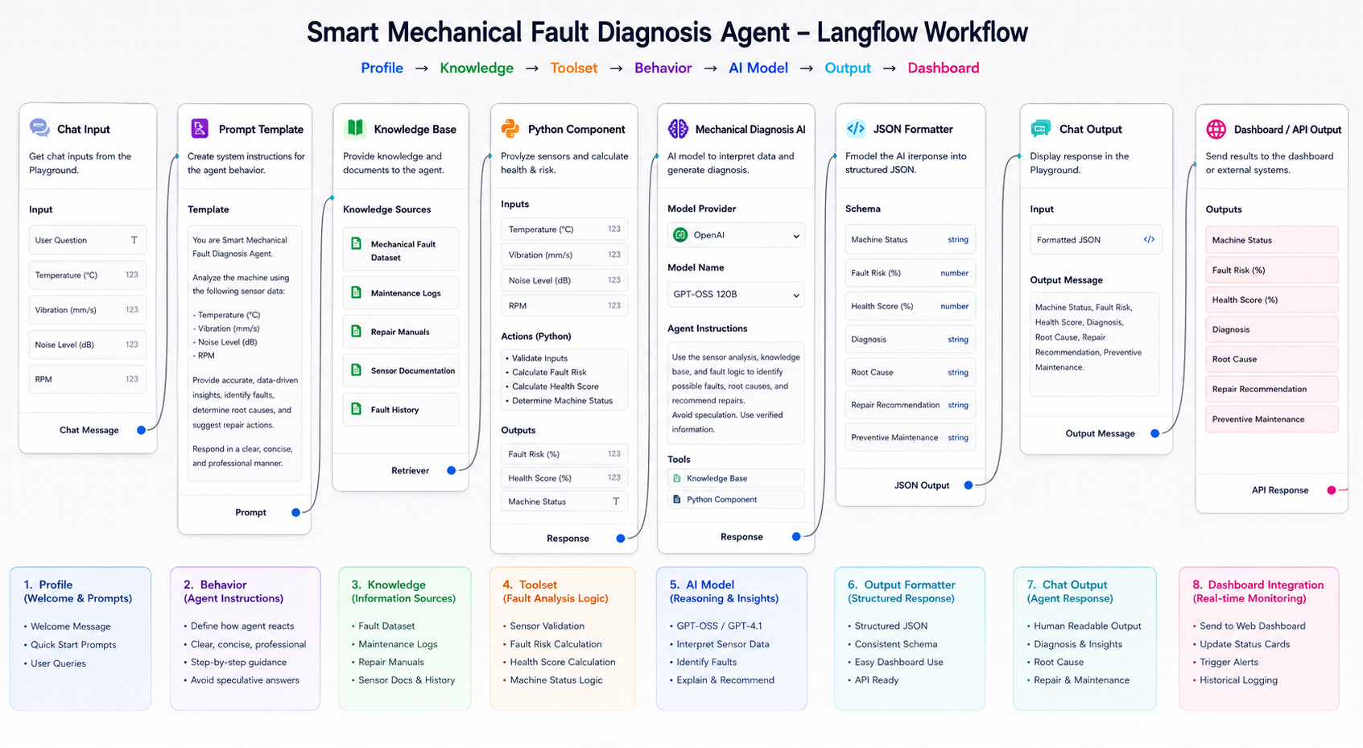
Langflow Workflow -

Slide 8
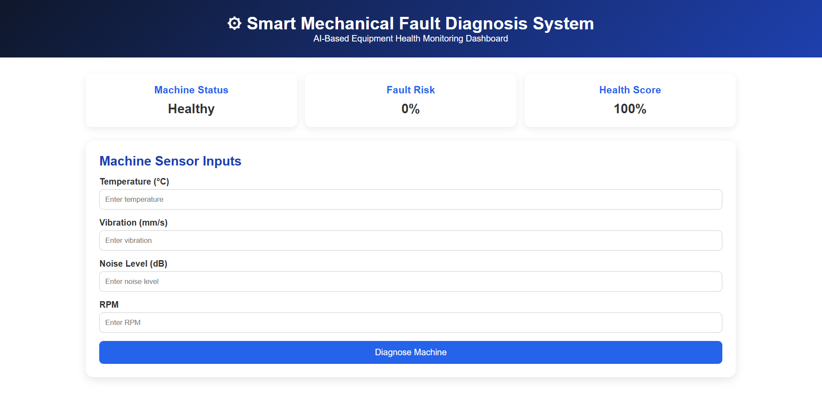
Smart Mechanical Fault Diagnosis Agent -

Slide 9
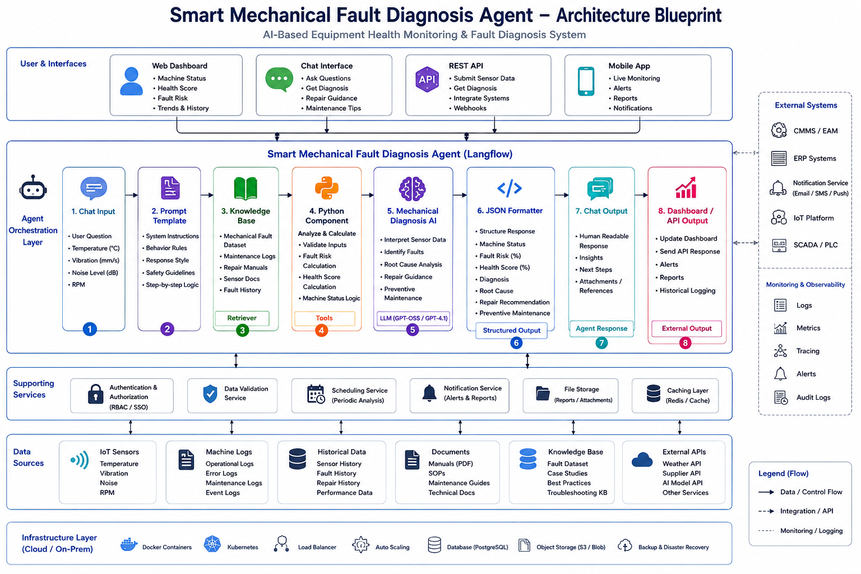
Architecture blueprint

Slide 10

Role of Agentic AI in the solution
In this solution, IBM watsonx.ai hosts the Granite foundation model, which acts as the core Agentic AI engine for the Smart Mechanical Fault Diagnosis System. The agent autonomously receives user queries and real-time machine sensor data (temperature, vibration, noise, and RPM), retrieves relevant knowledge from maintenance manuals, fault datasets, and historical logs, and orchestrates analytical tools to calculate machine health, fault risk, and identify root causes. Using the Granite model's reasoning capabilities, the agent generates accurate fault diagnoses, repair recommendations, and preventive maintenance guidance, delivering explainable, context-aware insights through the dashboard and APIs for proactive equipment monitoring and reduced downtime.

Slide 11
Git Hub Link-
Please create public github repository (Enable Add README button while creating repository) with format –
Please test and Paste the working Github URL –adityatupe38-lgtm/Smart-Mechanical-fault-diagnosis-agent: An AI-powered agent designed to diagnose mechanical faults in systems such as engines, pumps, and gearboxes. It analyzes sensor data, vibration patterns, and maintenance logs to identify symptoms, determine root causes, and provide repair guidance.

Slide 12
Novelty and Uniqueness
Agentic AI-powered solution using IBM watsonx.ai and the Granite foundation model for autonomous fault diagnosis and decision-making.
Hybrid approach combining real-time sensor data analysis with AI reasoning for more accurate fault detection.
Knowledge-driven diagnosis using maintenance manuals, historical fault logs, and technical documentation through Retrieval-Augmented Generation (RAG).
Explainable AI that provides root cause analysis, repair recommendations, and preventive maintenance instead of only fault predictions.
Real-time integration with IoT sensors, dashboards, and APIs for continuous machine health monitoring.
Scalable and modular architecture built using Langflow, allowing easy integration with enterprise maintenance systems and future AI tools.
Supports predictive maintenance, helping reduce equipment downtime, maintenance costs, and unexpected failures.

Slide 13
Future Scope
Integrate with live IoT sensors for continuous real-time machine monitoring.
Enhance prediction accuracy using larger industrial datasets and advanced AI models.
Support predictive maintenance by forecasting failures before they occur.
Extend compatibility to multiple types of industrial machines and equipment.
Integrate with CMMS/ERP systems for automated maintenance scheduling and work order generation.
Add multilingual support and voice-based interaction for maintenance personnel.
Develop a mobile application with real-time alerts and remote monitoring capabilities.
Incorporate digital twin technology for simulation and advanced fault analysis.

Slide 14
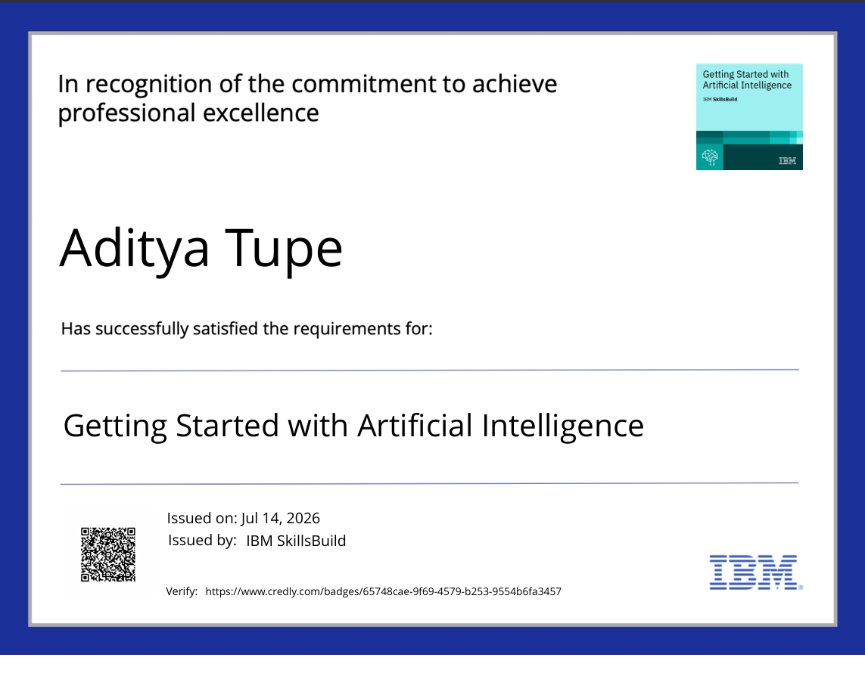
Certificates Earned -

Slide 15
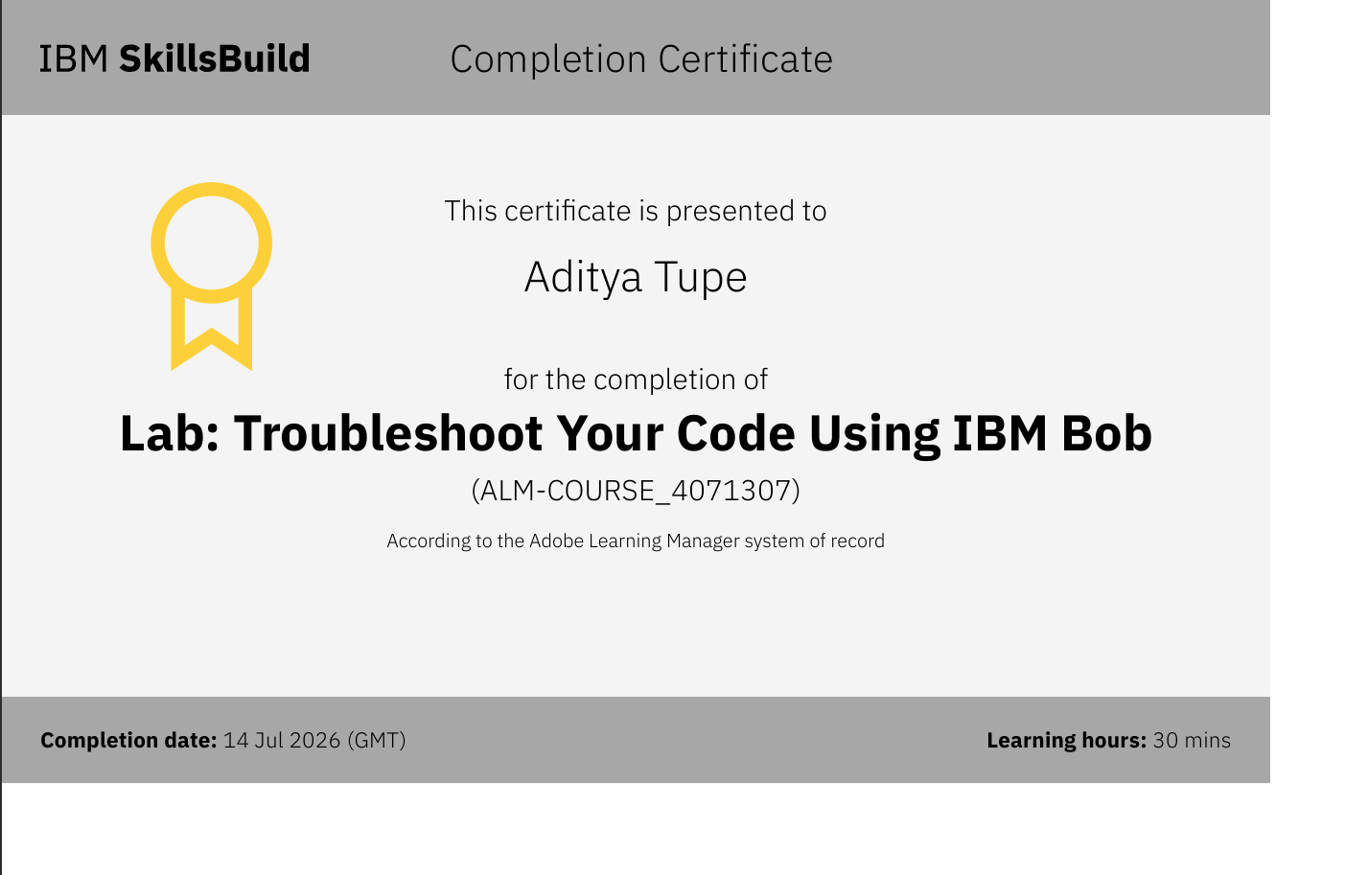

Slide 16
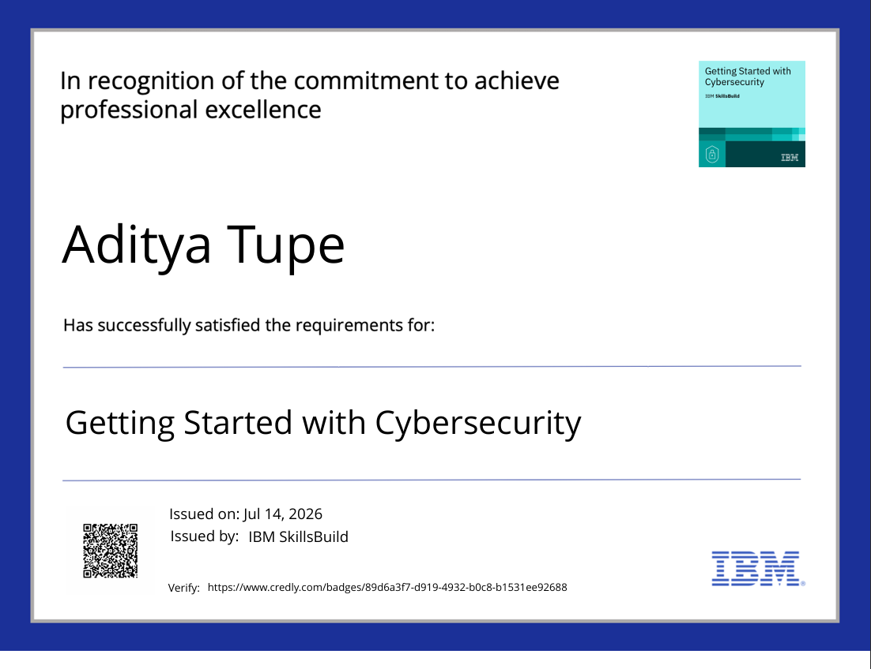

Slide 17
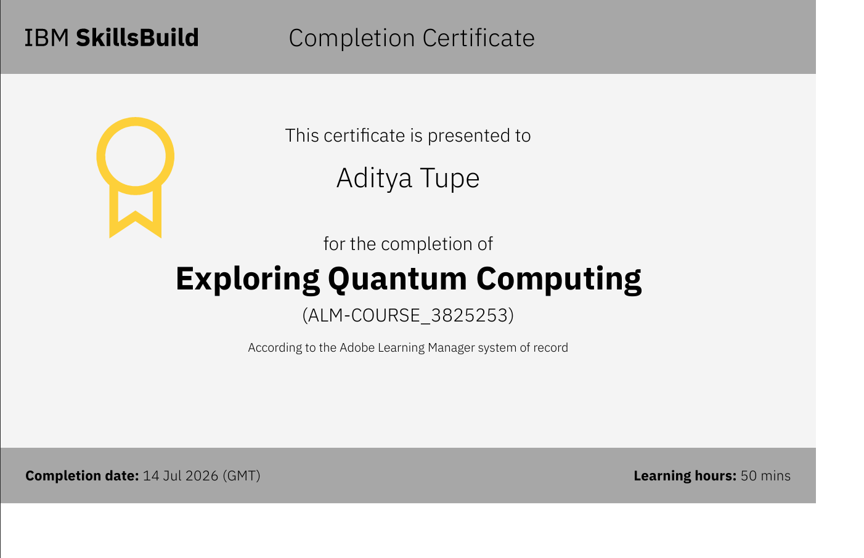

Slide 18


Slide 19
Thank you! Thank you for your time and interest

